Slide 1
GeneConnect
- Parser Demo

Slide 2
GeneConnect
Mapping service that will facilitate interoperability by interlinking approved genomic identifiers.
High Level Tasks
  An ETL (Extract, Transform, Load) tool to process the annotations
  Post processing to calculate all-to-all links
  Query Interface: Web Application, API, and Grid Data Service

Slide 3
GeneConnect High Level Block Diagram
GENECONNECT DATA SOURCES
GENECONNECT
ANNOTATION DATA SOURCES
GENECONNECT SERVER
GENECONNECT DATABASE
QUERY INTERFACE
WEB INTERFACE
API ACCESS
CAGRID DATA SERVICE

Slide 4
GeneConnect Architecture
AnnotationParser Library
Download Data File using FTP, HTTP API
Public Data Sources
J O B M A N A G E R
Spawn new thread
Data Downloader Thread
Push Downloaded file in queue
Data file queue
Unigene
External Parsers
Ensembl
Consume downloaded File
Spawn new thread
Data Transformer Thread
XMLRPC Server (for BLAST)
Transformed data file
Parsed data file queue
Spawn new thread
Database Loader Thread
Consume parsed file
Write data to GeneConnect database
Gene Connect Server
Correlate Genomic Identifiers
Gene Connect Database
HTTP request
Web Server
Web browser
API
caCORE API
Java Apps
Objects
caGRID API

Slide 5
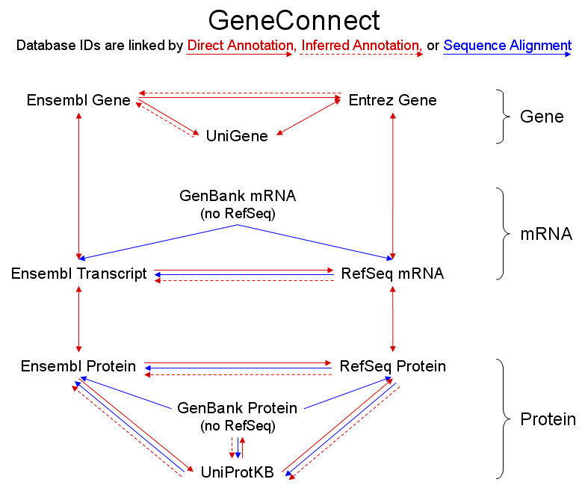
GeneConnect Data Sources

Slide 6
Configuration files
server.properties
  Set DB parameters
  Mail properties
  Location of command file etc.
CommandFile.xml
  Data source download info
  Parser details
Individual parser’s property file

Slide 7
GC First Run – Preparation run
Ensembl Gene
1 Direct
Entrez Gene
4 Direct
2 Inferred
3 Direct
5 Inferred
UniGene
6 Direct
7 Direct
GenBank mRNA
8 Seq. Alignment
9 Seq. Alignment
10 Direct
Ensembl Transcript
11 Seq Alignment
RefSeq mRNA
12 Inferred
13 Direct
15 Direct
14 Direct
Ensembl Protein
16 Seq Alignment
RefSeq Protein
17 Inferred
19 Seq Alignment
18 Seq Alignment
20 Direct
GenBank Protein
Preparation Run
22 Inferred
21 Seq Alignment
24 Seq Alignment
23 Direct
25 Inferred
BLAST destination
28 Inferred
27 Seq Alignment
26 Direct
UniProtKB

Slide 8
GC First Run – Contd.
Creates BLAST database
BLAST DB Parser steps
  Download FASTA file for BLAST destinations.
  Apply ‘formatdb’ on downloaded FASTA file.
Output
  BLAST Database files are created.

Slide 9
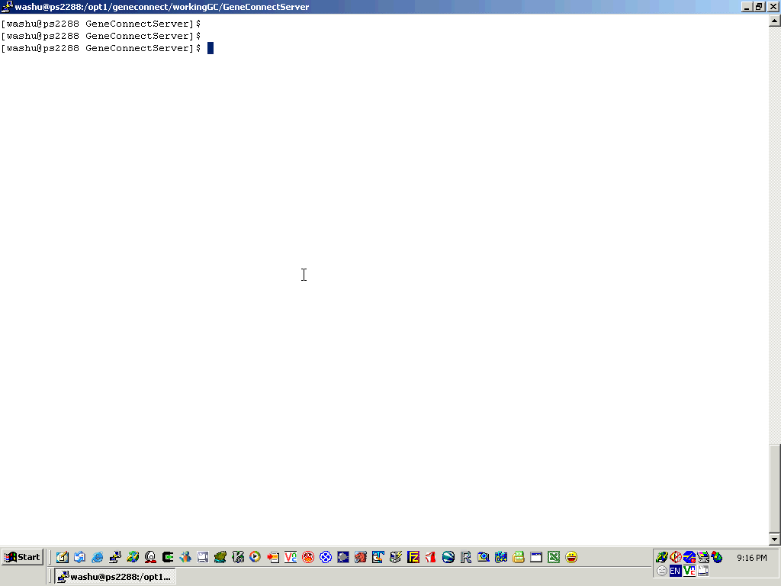

Slide 10
GC Second Run - Annotation parsers
1 ENSEMBLGENE_ENTREZGENE
Ensembl Gene
2 ENTREZGENE_ENSEMBLGENE
Entrez Gene
4 ENSEMBLGENE_UNIGENE
3 UNIGENE_ENTREZ
5 UNIGENE_ENSEMBLGENE
UniGene
6 ENSEMBLGENE_ENSEMBLTRANS
7 ENTREZGENE_REFSEQMRNA
GenBank mRNA
8 GENBANKMRNA_ENSEMBLTRANS
9 GENBANKMRAN_REFSEQMRNA
Ensembl Transcript
10 ENSEMBLTRANS_REFSEQMRNA
RefSeq mRNA
11 REFSEQMRNA_ENSEMBLTRANS
13 ENSEMBLTRANS_ENSEMBLPROTEIN
12 REFSEQMRNA_ENSEMBLTRANS
14 REFSEQMRNA_REFSEQPROTEIN
15 ENSEMBLPROT_REFSEQPROTEIN
Ensembl Protein
16 REFSEQPROTEIN_ENSEMBLPROT
RefSeq Protein
17 REFSEQPROTEIN_ENSEMBLPROT
19 Seq Alignment
18 Seq Alignment
21 Seq Alignment
GenBank Protein
23 UNIPROT_REFSEQPROTEIN
Annotation Parsers
20 ENSEMBLPROT_UNIPROT
24 REFSEQPROTEIN_UNIPROT
25 REFSEQPROTEIN_UNIPROT
Direct Annotation
22 UNIPROT_ENSEMBLPROT
26 GENBANKPROTEIN_UNIPROT
28 UNIPROT_GENBANKPROTEIN
Inferred Annotation
27 Seq Alignment
UniProtKB

Slide 11
GC Second Run – Contd.
Parses files and stores pairwise links in base tables
Annotation parsers
  Direct + Inferred links in graph
Steps
  Download annotation files
  Parse files to obtain pairwise links
  Upload pairwise links to base tables

Slide 12
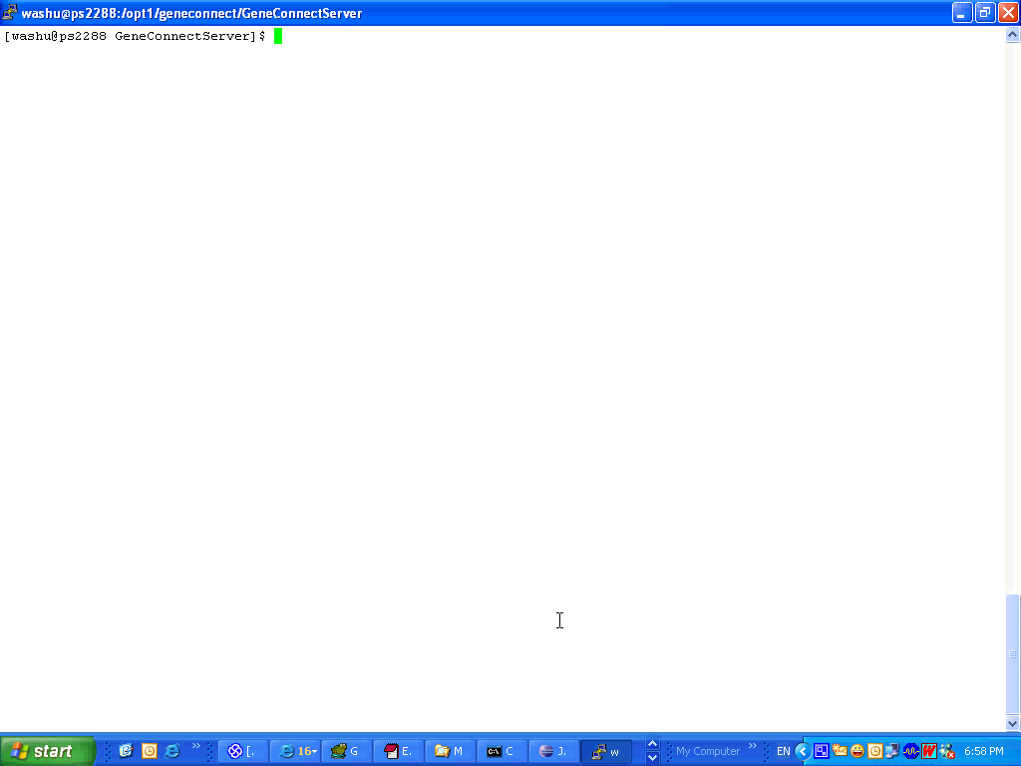

Slide 13
GC Third run - Sequence Alignment parsers
1 ENSEMBLGENE_ENTREZGENE
Ensembl Gene
2 ENTREZGENE_ENSEMBLGENE
Entrez Gene
4 ENSEMBLGENE_UNIGENE
3 UNIGENE_ENTREZ
5 UNIGENE_ENSEMBLGENE
UniGene
6 ENSEMBLGENE_ENSEMBLTRANS
7 ENTREZGENE_REFSEQMRNA
GenBank mRNA
8 GENBANKMRNA_ENSEMBLTRANS
9 GENBANKMRAN_REFSEQMRNA
Ensembl Transcript
10 ENSEMBLTRANS_REFSEQMRNA
RefSeq mRNA
11 REFSEQMRNA_ENSEMBLTRANS
13 ENSEMBLTRANS_ENSEMBLPROTEIN
12 REFSEQMRNA_ENSEMBLTRANS
14 REFSEQMRNA_REFSEQPROTEIN
15 ENSEMBLPROT_REFSEQPROTEIN
Ensembl Protein
16 REFSEQPROTEIN_ENSEMBLPROT
RefSeq Protein
17 REFSEQPROTEIN_ENSEMBLPROT
19 GENBANKPROT
_REFSEQPROTEIN
GenBank Protein
Sequence Alignment Parsers
18 GENBANKPROT
_ENSEMBLPROT
23 UNIPROT_REFSEQPROTEIN
20 ENSEMBLPROT_UNIPROT
24 REFSEQPROTEIN_UNIPROT
21 UNIPROT_ENSEMBLPROT
25 REFSEQPROTEIN_UNIPROT
Sequence Alignment links
22 UNIPROT_ENSEMBLPROT
27 GENBANKPROTEIN_UNIPROT
26 GENBANKPROTEIN_UNIPROT
28 UNIPROT_GENBANKPROTEIN
UniProtKB

Slide 14
GC third run – Contd.
Performs alignment algorithm and stores pairwise links in base tables
Sequence alignment source parsers
  Sequence-alignment links in graph
Steps
  Download source FASTA files
  Perform sequence alignment steps (using XMLRPC set up)
  Upload pairwise links to base tables

Slide 15
GeneConnect
- XML RPC Demo

Slide 16
Start split jobs
Get params
Update status
Return results
split_fasta_files.pl
Manager
Job Queue
Cluster::Job
Cluster::JobQueue
GeneConnect
Client
background
Machine Queue
Cluster::Machine
Cluster::MachineQueue
Cluster::QueueManager
Start DB jobs
Check status
Return results
Job Status
Database
XML-RPC
Server
DBM::Deep
GeneConnect::Params
Manager
Job Queue
Cluster::Job
Cluster::JobQueue
SSH
Machine Queue
Cluster::Machine
Cluster::MachineQueue
Start chunk jobs
Get params
Update status
Create results files
Return results
Restart if error
Cluster::QueueManager
Compute Nodes
(Seq Align Pipeline)

Slide 17
XML RPC System
Input:
  One configuration file
  Parameters passed to the system

Slide 18
XML RPC Configuration File
# This is the config file for the GeneConnect XML RPC system
[server]
IP = "192.168.3.2"
URL = "http://im-vishnu.wustl.edu"
port = 4201
machine_name = "im-vishnu"
max_num_jobs = 1
path_to_split_fasta_file = "/home/clususer/geneconnect/XML_RPC_system/persistent"
[compute_nodes]
machines_file_name = "machines.txt"
machines_file_path = "/home/clususer/geneconnect/XML_RPC_system/persistent"
path_to_gc_seq_align_pipeline = "/state/partition1/geneconnect"
working_directory = "/state/partition1/geneconnect"

Slide 19
Parameters Passed to the XML RPC System
SRCFILE => 'fastarefmrna10.fasta',
DESTINATIONDB => 'Homo_sapiens.NCBI36.apr.cdna.fa',
PATHS => {
base => '/home/clususer/geneconnect/XML_RPC_system/persistent/',
source => '/home/clususer/geneconnect/XML_RPC_system/persistent/',
db => '/state/partition1/blastDB/',
output => '/home/clususer/geneconnect/XML_RPC_system/persistent/',
},
CONFIG => {
numSeqsPerJob => 1,
saveAlignOutput => 1,
controlFileHeader => 'header for control file',
controlFileColumnSeparator => '###',
},
BLAST => {
blastType => 'blastn',
EValue => 1e-25,
ScoringMatrix => 'BLOSUM62',
GapOpenCost => undef,
GapExtensionCost => undef,
Dropoff => undef,
WordSize => undef,
seqType => 'nucleotide',
},
BLAST_FILTER => {
PercentSequenceAlignment => 0.80,
},
NEEDLE => {
GapOpenCost => undef,
GapExtend => undef,
Matrix => undef,
},
NEEDLE_FILTER => {
PercentSequenceAlignment => 0.90,
SimilarityScore => 0.90,
IdentityScore => 0.90,
NumberMisMatch => 2,
},

Slide 20
XML RPC System
Output:
  File containing mapped IDs (for db upload)
  Log files
Output File Containing Mapped IDs:
header for control file
NR_000005###ENST00000363401###identity
NM_004604###ENST00000313843###alignment

Slide 21
